Slide 1

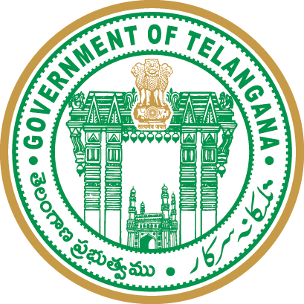


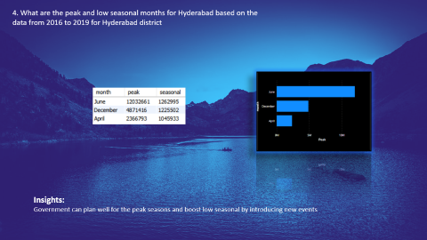
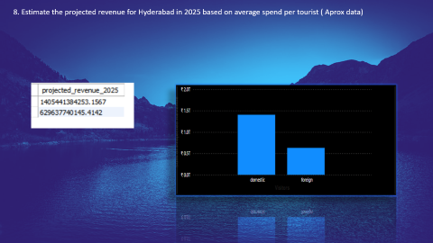
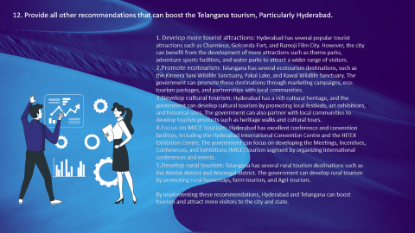
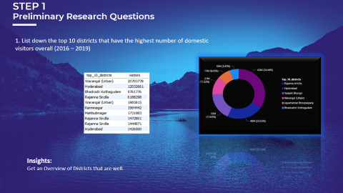
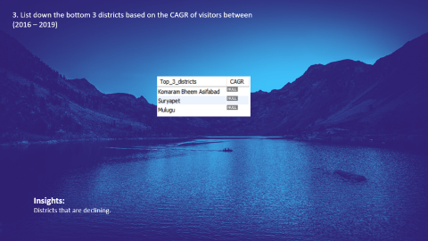
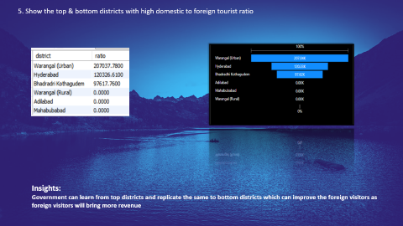
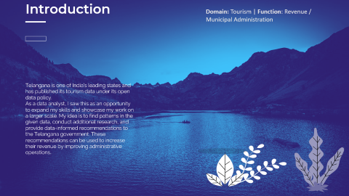
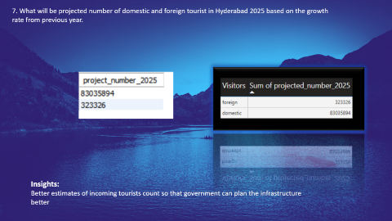
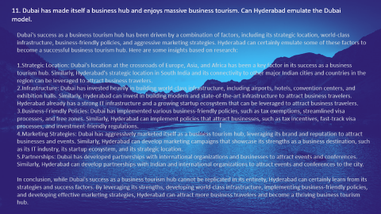
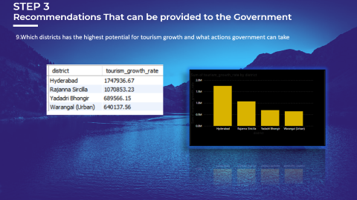

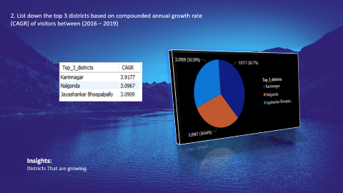
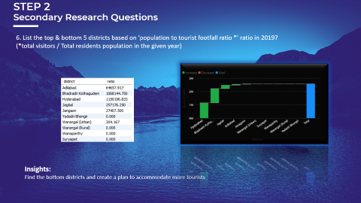
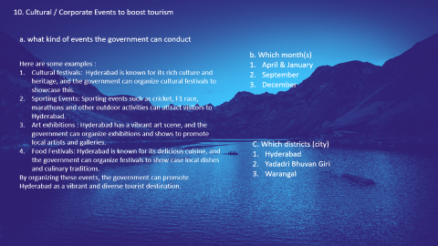
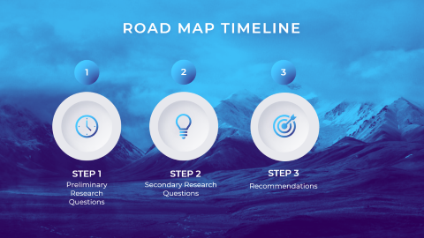
Presented By
Rajesh Gottoju
Provide Insights To Telangana Government Tourism Department
Notes:
https://duotone.shapefactory.co/?i=-HH3cGeAC4o&f=3fc7ff&t=2c0058&q=_
https://duotone.shapefactory.co/?f=3fc7ff&t=2c0058&q=_

Slide 2
Presented By
Rajesh Gottoju
Provide Insights To Telangana Government Tourism Department
Notes:
https://duotone.shapefactory.co/?i=-HH3cGeAC4o&f=3fc7ff&t=2c0058&q=_
https://duotone.shapefactory.co/?f=3fc7ff&t=2c0058&q=_

Slide 3
Introduction
Domain: Tourism | Function: Revenue / Municipal Administration
Telangana is one of India’s leading states and has published its tourism data under its open data policy.
As a data analyst, I saw this as an opportunity to expand my skills and showcase my work on a larger scale. My idea is to find patterns in the given data, conduct additional research, and provide data-informed recommendations to the Telangana government. These recommendations can be used to increase their revenue by improving administrative operations.
Notes:
https://storyset.com/illustration/meditation/bro
https://duotone.shapefactory.co/?i=-HH3cGeAC4o&f=3fc7ff&t=2c0058&q=_

Slide 4

ROAD MAP TIMELINE
1
2
3
STEP 1
STEP 2
STEP 3
Preliminary Research Questions
Secondary Research Questions
Recommendations
Notes:
https://duotone.shapefactory.co/?i=roZgc7SXXmI&f=3fc7ff&t=2c0058&q=_

Slide 5


AGENDA
STEP 1 | Preliminary Research Questions
Preliminary research questions are the initial questions that a researcher asks when beginning a research project. These questions are designed to help the researcher gain an understanding of the topic, identify potential research problems or gaps in the literature, and develop a clear research focus.
STEP 2 | Secondary Research Questions
Secondary research questions are the questions that a researcher asks when conducting secondary research, which is the process of gathering information from existing sources such as academic literature, government reports, or market research reports. These questions are designed to help the researcher identify and gather relevant information that can be used to address the research problem or question.
STEP 3 | Recommendations
Notes:
https://duotone.shapefactory.co/?i=phIFdC6lA4E&f=3fc7ff&t=2c0058&q=_

Slide 6
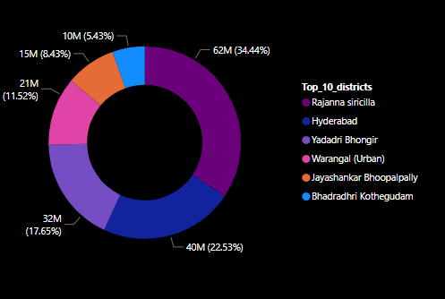
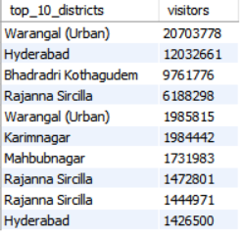
STEP 1
Preliminary Research Questions
1. List down the top 10 districts that have the highest number of domestic visitors overall (2016 – 2019)
Insights:
Get an Overview of Districts that are well.

Slide 7
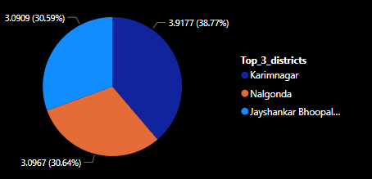
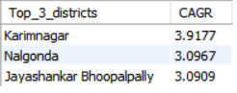
2. List down the top 3 districts based on compounded annual growth rate (CAGR) of visitors between (2016 – 2019)
Insights:
Districts That are growing.

Slide 8
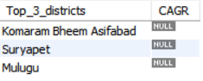
3. List down the bottom 3 districts based on the CAGR of visitors between (2016 – 2019)
Insights:
Districts that are declining.

Slide 9
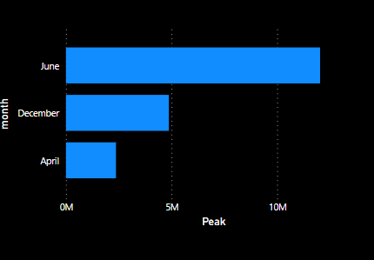
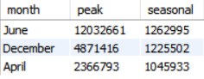
4. What are the peak and low seasonal months for Hyderabad based on the data from 2016 to 2019 for Hyderabad district
Insights:
Government can plan well for the peak seasons and boost low seasonal by introducing new events

Slide 10
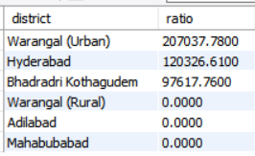
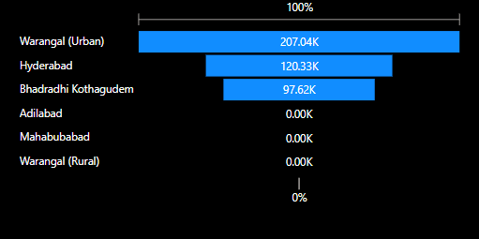
5. Show the top & bottom districts with high domestic to foreign tourist ratio
Insights:
Government can learn from top districts and replicate the same to bottom districts which can improve the foreign visitors as foreign visitors will bring more revenue

Slide 11
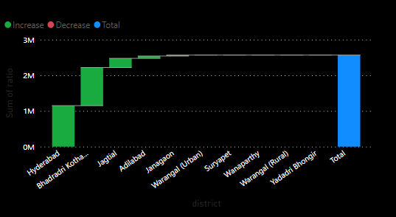
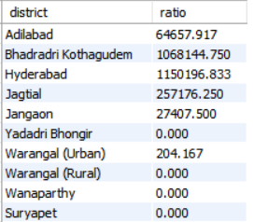
STEP 2
Secondary Research Questions
6. List the top & bottom 5 districts based on 'population to tourist footfall ratio *' ratio in 2019? (*total visitors / Total residents population in the given year)
Insights:
Find the bottom districts and create a plan to accommodate more tourists

Slide 12
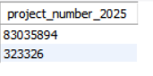
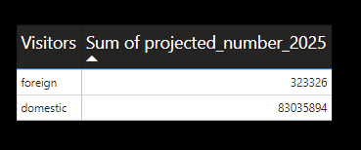
7. What will be projected number of domestic and foreign tourist in Hyderabad 2025 based on the growth rate from previous year.
Insights:
Better estimates of incoming tourists count so that government can plan the infrastructure better

Slide 13
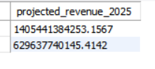
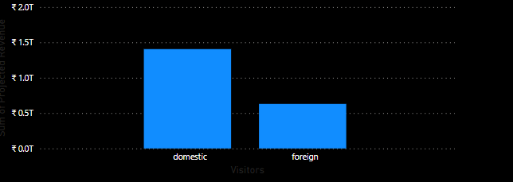
8. Estimate the projected revenue for Hyderabad in 2025 based on average spend per tourist ( Aprox data)

Slide 14
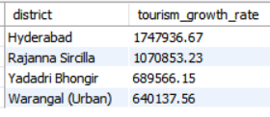
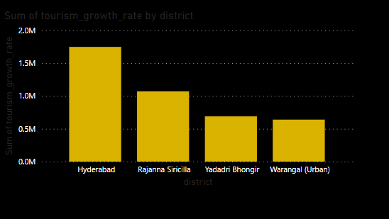
STEP 3
Recommendations That can be provided to the Government
9.Which districts has the highest potential for tourism growth and what actions government can take

Slide 15
10. Cultural / Corporate Events to boost tourism
a. what kind of events the government can conduct
b. Which month(s)
April & January
September
December
Here are some examples :
Cultural festivals: Hyderabad is known for its rich culture and heritage, and the government can organize cultural festivals to showcase this.
Sporting Events: Sporting events such as cricket, F1 race, marathons and other outdoor activities can attract visitors to Hyderabad.
Art exhibitions : Hyderabad has a vibrant art scene, and the government can organize exhibitions and shows to promote local artists and galleries.
Food Festivals: Hyderabad is known for its delicious cuisine, and the government can organize festivals to show case local dishes and culinary traditions.
By organizing these events, the government can promote Hyderabad as a vibrant and diverse tourist destination.
C. Which districts (city)
Hyderabad
Yadadri Bhuvan Giri
Warangal

Slide 16
11. Dubai has made itself a business hub and enjoys massive business tourism. Can Hyderabad emulate the Dubai model.
Dubai's success as a business tourism hub has been driven by a combination of factors, including its strategic location, world-class infrastructure, business-friendly policies, and aggressive marketing strategies. Hyderabad can certainly emulate some of these factors to become a successful business tourism hub. Here are some insights based on research:
Strategic Location: Dubai's location at the crossroads of Europe, Asia, and Africa has been a key factor in its success as a business tourism hub. Similarly, Hyderabad's strategic location in South India and its connectivity to other major Indian cities and countries in the region can be leveraged to attract business travelers.
Infrastructure: Dubai has invested heavily in building world-class infrastructure, including airports, hotels, convention centers, and exhibition halls. Similarly, Hyderabad can invest in building modern and state-of-the-art infrastructure to attract business travelers. Hyderabad already has a strong IT infrastructure and a growing startup ecosystem that can be leveraged to attract business travelers.
Business-Friendly Policies: Dubai has implemented various business-friendly policies, such as tax exemptions, streamlined visa processes, and free zones. Similarly, Hyderabad can implement policies that attract businesses, such as tax incentives, fast-track visa processes, and investment-friendly regulations.
Marketing Strategies: Dubai has aggressively marketed itself as a business tourism hub, leveraging its brand and reputation to attract businesses and events. Similarly, Hyderabad can develop marketing campaigns that showcase its strengths as a business destination, such as its IT industry, its startup ecosystem, and its strategic location.
Partnerships: Dubai has developed partnerships with international organizations and businesses to attract events and conferences. Similarly, Hyderabad can develop partnerships with Indian and international organizations to attract events and conferences to the city.
In conclusion, while Dubai's success as a business tourism hub cannot be replicated in its entirety, Hyderabad can certainly learn from its strategies and success factors. By leveraging its strengths, developing world-class infrastructure, implementing business-friendly policies, and developing effective marketing strategies, Hyderabad can attract more business travelers and become a thriving business tourism hub.
l

Slide 17


12. Provide all other recommendations that can boost the Telangana tourism, Particularly Hyderabad.
Develop more tourist attractions: Hyderabad has several popular tourist attractions such as Charminar, Golconda Fort, and Ramoji Film City. However, the city can benefit from the development of more attractions such as theme parks, adventure sports facilities, and water parks to attract a wider range of visitors.
Promote ecotourism: Telangana has several ecotourism destinations, such as the Kinnera Sani Wildlife Sanctuary, Pakal Lake, and Kawal Wildlife Sanctuary. The government can promote these destinations through marketing campaigns, eco-tourism packages, and partnerships with local communities.
Develop cultural tourism: Hyderabad has a rich cultural heritage, and the government can develop cultural tourism by promoting local festivals, art exhibitions, and historical sites. The government can also partner with local communities to develop tourism products such as heritage walks and cultural tours.
Focus on MICE tourism: Hyderabad has excellent conference and convention facilities, including the Hyderabad International Convention Centre and the HITEX Exhibition Centre. The government can focus on developing the Meetings, Incentives, Conferences, and Exhibitions (MICE) tourism segment by organizing international conferences and events.
Develop rural tourism: Telangana has several rural tourism destinations such as the Medak district and Warangal district. The government can develop rural tourism by promoting rural homestays, farm tourism, and Agri-tourism.
By implementing these recommendations, Hyderabad and Telangana can boost tourism and attract more visitors to the city and state.
Notes:
https://storyset.com/illustration/business-plan/bro
https://duotone.shapefactory.co/?i=c65n6pgkXkI&f=3fc7ff&t=2c0058&q=_

